Slide 1
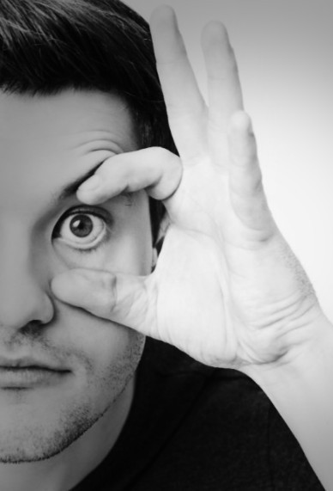

Vigilance Guard: Monitoring Fatigueness
Team Members: Ganga Vamsik Sanipinidi
Sai Revanth Myneni

Slide 2
Problem Statement
The problem of fatigueness/drowsiness among drivers globally impacts millions of individuals on the road.
Our drowsiness detection algorithm is engineered to tackle this issue by employing advanced technology to identify signs of drowsiness in human eyes, where we monitor eye movement using the AI models that tracks eye movement and blink rate to detect fatigue of driver.

Slide 3
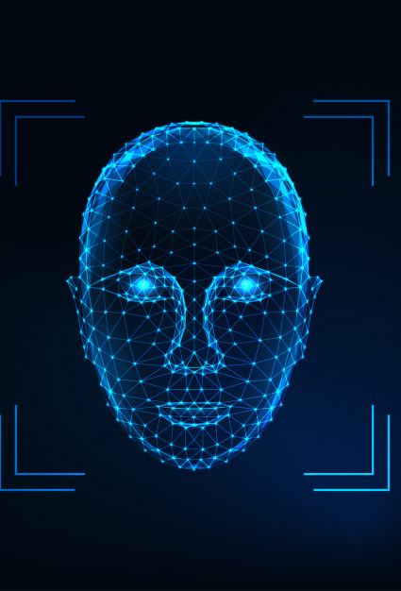
Project Overview
Data Collection: Data Set is taken from Kaggle: Closed-Open Eyes Detection ResNet50 (kaggle.com)
Model Development: Design and implement a machine learning and deep learning model for drowsiness detection with different model architectures.
Training and Validation: Train the drowsiness detection model using the preprocessed dataset, dividing it into training, validation, and testing sets. Monitor the model's performance during training, adjusting hyperparameters and model architecture as needed to improve accuracy and generalization. And finally evaluating the model.

Slide 4
Methodology
This system is a observational approach where standard metrics such as accuracy precision and loss are employed to evaluate the models. The performance of the models is monitored throughout multiple epochs during training and validation to gauge their effectiveness.
Code demonstrates a typical workflow for training, evaluating, and visualizing the performance of CNN models for image classification tasks, with the use of pre-trained models, custom architectures, and standard evaluation metrics.
Obtaining labeled drowsiness data can be challenging, especially with variations in drowsiness levels and environmental conditions.

Slide 5
Contd.
Model 1: Mobilenet V2 is a CNN architecture designed for efficient model performance with Depthwise Separable Convolutions. And with the introduction of width and resolution multipliers by MobileNetV2, users can scale the input image resolution and model's width (number of channels) to balance computational requirements and accuracy.
Model 2: Personalized Model, this model is composed of multiple convolutional layers, each with an activation function of Rectified Linear Units (ReLU) and a 3x3 kernel. The goal of the model is to produce a probability that represents the likelihood that the input falls into one of the two classes in the dataset.

Slide 6
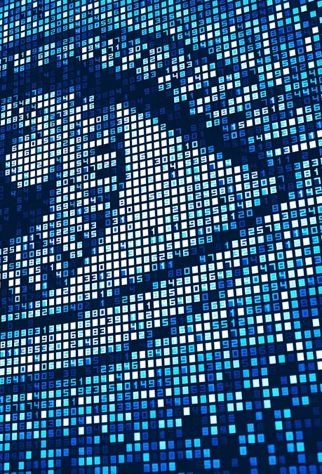
Future Improvements
Early Warning System: Provide timely alerts or warnings to the individual
Adaptability: Adapting to different lighting conditions
Integration: Integrating to VMS in vehicles, smart glasses
Other applications: Healthcare, Industrial safety purpose

Slide 7
References
MRL Eye Dataset | MRL (vsb.cz)
Our Projects | MRL (vsb.cz)

